Slide 1
Team Effectiveness
Greater alignment of senior team on priorities that drive value creation

Slide 2
We Start by Understanding the Company & Speaking with the People
Strategy Documents
1:1 Interviews
Stakeholder feedback
Board Conversations
Employee Engagement Survey
Team
Personality
Profiles
Leadership
Culture Survey
Shareholder Conversations

Slide 3
We Align on the Company’s Strategic Pivots
CONFIDENTIAL – NOT TO BE SHARED
From…
To…
UAE-focused operations
Market Expansion into new geographies
Low maturity of systems and processes
Operational excellence with digital-enabled operations
Ad-hoc culture, weak governance, fragmented focus
Values, outcome-driven, one-team culture with clear priorities, high accountability, and performance standards
AED 5Bn
Revenue
AED 10Bn
Revenue
2025
RESULTS
2030
ASPIRATION
Mid-case including M&A
AED 0.5Bn
EBITDA
AED 2Bn
EBITDA

Slide 4


We First Define the Jobs to Be Done for Each Leader
CONFIDENTIAL – NOT TO BE SHARED
I.e. Chief Finance Officer
Jobs to Be Done Pivot
Jobs to Be Done
Superpowers
From: Finance function focused on reporting and compliance with manual, Excel-based transactional processes
To: Strategic finance partner enabling growth through real-time visibility, M&A execution, disciplined capital allocation, and investor relations excellence as a listed company
[30%] Execute strategic M&A and disciplined capital allocation by leading financial evaluation, structuring, and due diligence for acquisitions and strategic opportunities—deploying capital to drive inorganic growth, optimizing resource allocation across business priorities, and managing debt and treasury to fund international expansion [25%] Modernize financial infrastructure eliminating invoicing lags, achieving full automation of core financial reporting, and transitioning from manual Excel-based operations to integrated enterprise systems [20%] Optimize commercial finance and working capital to implement data-backed costing and pricing mechanisms, drive inventory reduction, improve cash conversion, and institutionalize profitability analysis to protect margins [15%] Institutionalize investor relations and governance by crafting a compelling equity story centered on the phygital transformation, managing public market expectations, strengthening internal controls, and building credibility with analysts as a listed entity [10%] Build finance team capability by developing talent across strategic finance, commercial partnering, and M&A integration—embedding business acumen and commercial mindset through training and development to support a more complex organization
Capital markets & Strategic Finance Mastery: Simultaneously manage public market expectations, structure complex M&A transactions, and optimize capital allocation—translating operational transformation into a compelling equity story while deploying balance sheet for strategic growth
Finance Transformation & Operational Partnership: Rebuild financial infrastructure while partnering with commercial and industrial leaders to drive performance—serving as both architect of financial systems and business partner for margin improvement

Slide 5
We Use These to Define the Shared JTBDs for the Leadership Team
CONFIDENTIAL – NOT TO BE SHARED
Jobs to Be Done Pivot
Jobs to Be Done
Superpowers
From: Leadership team of functional experts operating in silos and dependent on CEO for direction and client relationships
To: Aligned executive team with clear ownership, shared accountability for results, disciplined execution rhythm, and collective responsibility for delivering transformation while protecting the core business
Deliver 2026 financial commitments, execute the strategy, and protect all client relationships by securing renewal of critical contracts, achieving revenue and EBITDA targets and advancing strategic initiatives that position the company for long-term growth Establish execution rhythm with clear accountability by creating performance operating cadence where initiatives have owners, milestones, and consequences Clarify operating model and role accountabilities by defining functional mandates, decision rights, and ownership so everyone knows who is responsible for what and can execute without confusion Build high-performance culture and critical capabilities by embedding values of Trust, Teamwork, and Accountability, attracting talent for priority roles, and developing Emirati professionals for key positions
Collective Accountability & Constructive Challenge: The ability to hold each other accountable for commitments, call out delays without defensiveness, and demand performance from peer; creating a team where candor is expected and excuses are not accepted
One-Team Behavior Across Boundaries: The ability to put enterprise outcomes ahead of functional interests, support each other's success, and operate with transparency; where wins are shared, problems are surfaced early, and no one succeeds unless the team succeeds

Slide 6
Energy spent versus energy required
CONFIDENTIAL – NOT TO BE SHARED
Energy Spent
Energy Required
Everything vs. Focus
14 initiatives, chasing every opportunity
3 priorities that bend the value curve
Past vs. Future
Explaining inherited problems, compliance
Building infrastructure that delivers future results
Care vs. Accountability
Supporting the team, well being
Demanding results, enforcing consequences, addressing underperformance
Rewards vs. Results
Designing incentives and compensation
Retaining and acquiring new clients
Networks vs. Systems
Personal relationships for quick wins
Scalable processes

Slide 7
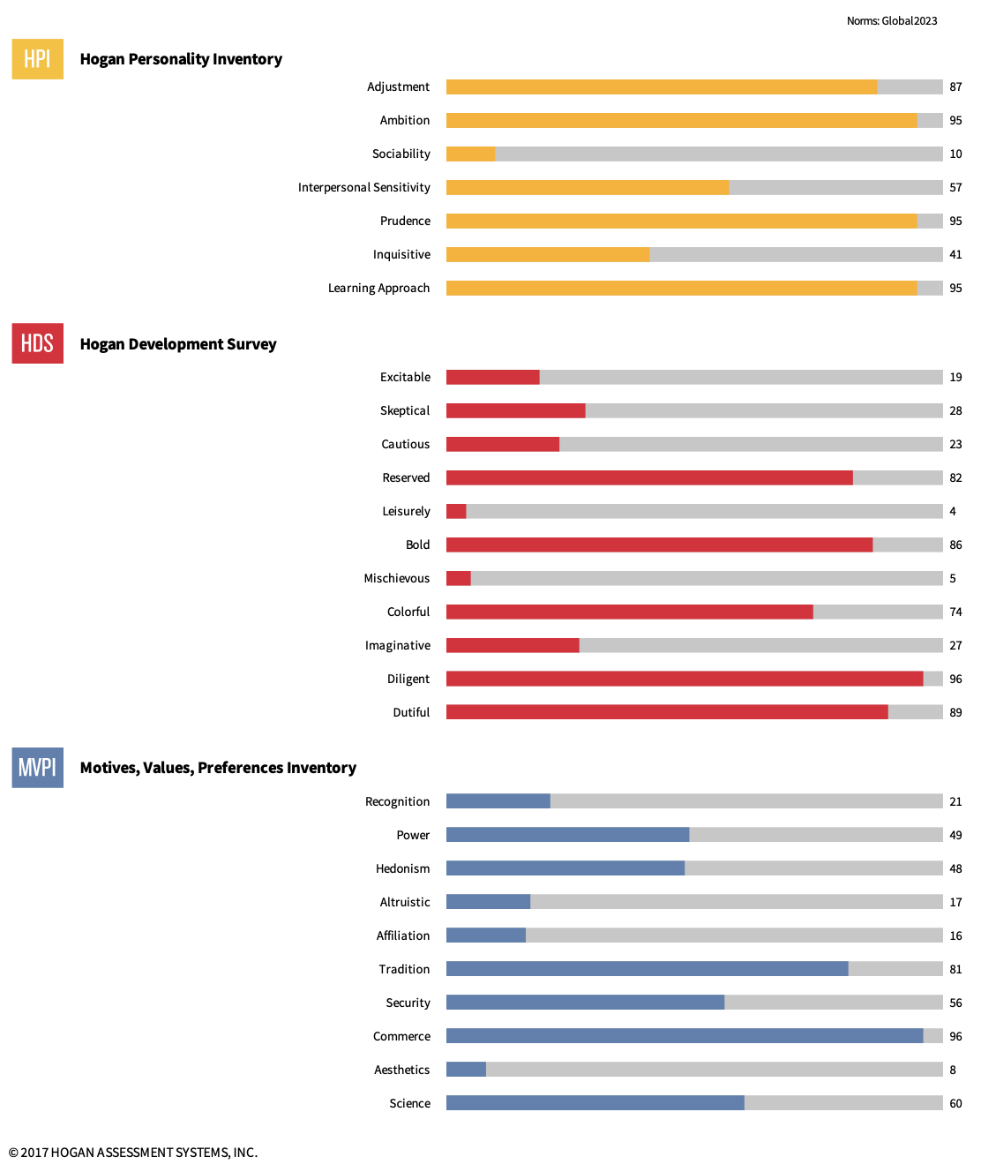
We Conduct Hogan Personality for Each Leader
CONFIDENTIAL – NOT TO BE SHARED
I.e. Chief Finance Officer
Role
Talent
Chief Financial Officer
John X
John is the anchor on a team. When things get chaotic, he stays steady (Adjustment: 87). He brings rigor to everything he does (Prudence: 95; Diligent: 96)—his attention to process, governance, and detail is exceptional. He goes deep (Learning Approach: 95) and values expertise and mastery. The organization can count on him to get things right.
When pressure mounts, John's instinct may be to focus and work through things on his own (Reserved: 82; Sociability: 10). This could make it harder for others to know where they stand —brief, intentional check-ins help maintain connection. He may also have a tendency to defer to authority (Dutiful: 89) and while this is a strength, his role requires him to push back when he sees risk.
What drives John is financial performance (Commerce: 96)—he wants the company to succeed commercially and measures success in results. Relationships matter to him, but outcomes matter more.
Can enhance impact through:
Partnering with Ahmed on governance —both are highly disciplined and commercially aligned but can also occasionally withdraw, helping each other reach out proactively can keep things connected.
Serving as guardrails for the CEO who prefers moving fast and may not always enforce process.

Slide 8


We Provide Insights for How the Leadership Team Works
CONFIDENTIAL – NOT TO BE SHARED
Tailwinds
Headwinds
Intellectually strong
(Learning)
Work independently rather than interdependently
Commercially astute
Low on Empathy
High Team Motivation
Low on Process
Highly driven (Ambition)
Quick to frustration when things don't go as planned

Slide 9


We Identify Team Dynamics
CONFIDENTIAL – NOT TO BE SHARED
Tailwinds
Headwinds
Struggle under pressure:
60% of team may become reactive or withdraw
John and Diana comfortable with pressure
Communication collapse:
Under stress, the majority may shut down
Information flow fails when it matters most
Low emotional attunement:
Maz and Ahmed may be perceived as distant
Diana and John best at reading the room
Process discipline concentrated:
Only John and Ahmed are high on Process.
John - the team’s process anchor: stability, discipline, and governance
Diana - the team's connector: relationships, judgement and local nuances:
Maz - the team’s expert: deep technical expertise
Ahmed : the team's operator: operational discipline and process rigor
Tina : Farming and client relations
John & Ahmed: High process proﬁles, both disciplined and commercial; Risk: both withdraw under pressure, may silo
Diana and All Peers: The team's connector; Use her to bridge silos and facilitate diﬃcult conversations
Maz & Ahmed: Both stress-sensitive and withdrawn; Under pressure, both will go silent
Tina & Maz: Won't naturally collaborate; Tina won't assert; Maz won't engage
Key peer-to-peer dynamics

Slide 10





We Facilitate Team Offsite
CONFIDENTIAL – NOT TO BE SHARED
What High Performing Teams Do (differently)
Shared Values and Clarity of Goals
A Shared
Story
Psychological Safety
Belonging Is Fundamental
Ritualize High Performance Behaviors

Slide 11




During the Offsite, We Jointly Develop the High-performance Team Journey
CONFIDENTIAL – NOT TO BE SHARED
Strong Start & Building Blocks for a High-performance Team
On-point Messaging from CEO – Why Now + Unique Window of Opportunity
Emerging Sense of Collective Ownership & Identity as Enterprise Leaders
Continue the Team Building Journey
Hold 2 in-person team offsites per year to align on priorities and execution plans, review progress and interdependencies, strengthen trust and collaboration.
Continue team building activities to build stronger personal relationships- could include simple lunches, coffee.
Continue to encourage Chiefs to shift from functional to enterprise leadership where it matters (key question: does this topic require team input and if so how early, or can it be handled within my function?)
Interdependencies
Identify top 5 task interdependencies and regularly discuss progress in weekly team meetings (on rotating basis)
What trade-offs need to be made to deliver on priorities? Where do we need to reallocate resources to move faster?
Call out interdependencies early—if your decision affects another function, align before acting.
Build transparency—share roadblocks and ask for help where needed.
Who do I depend on to deliver for me? How can I help enable others’ priorities?
Role Model
Jointly communicate with organization to role model values & behaviors (incl. joint scorecard for Chiefs)
Strengthen committees (priorities, decision making, information flow) to drive cross functional excellence.
Review role of LT members in committees to further empower, increase delegation and increase pace.

Slide 12
We Develop Enabling Plan for Each Leader to Support the Team
CONFIDENTIAL – NOT TO BE SHARED
I.e. CHRO
Building Critical Capabilities
Identify and build critical roles and capabilities the organization needs for growth—digital, pricing
Work with the CEO to define clear JTBDs for l2s and all critical roles using your influencing skills. This creates clarity on what success looks like and enables better hiring and performance conversations.
Build your own HR team capacity so you have bandwidth to focus on strategic priorities. Bring in dedicated ta and HR operations leadership to free your time
Completing Organizational Foundations
Finalize the operating model by March 2026 and restructure key functions to align talent to value creation.
Deliver org designs for manufacturing and other functions that need structural clarity.
Leverage your relationship with NRC for support on organizational design and people strategy. Their perspective and backing strengthens your initiatives.
Driving Performance Culture and Leadership Effectiveness
Drive performance accountability through the performance management cascade. Ensure L3 goals are clear and tracked. Address underperformance when IT occurs.
Design offsites, facilitate ways of working discussions, and help build trust across the N-1.
Leveraging Your Strengths
Focus on 3-4 priorities that matter most. Hogan shows tendency to take on many things because you can do IT which is a strength when channeled—disciplined prioritization ensures you complete what matters.
Success Enabling Plan
What are We Solving For?
Building Critical Capabilities for Growth — The transformation requires new capabilities the organization doesn't have today—digital, pricing, commercial infrastructure.
Completing Organizational Foundations — Finalize the operating model and deliver org designs for manufacturing and other functions. Ensure clear JTBDs exist for all critical roles so the organization knows what success looks like.
Driving Performance Culture and Leadership Effectiveness — Embed accountability through performance management. Support the CEO in building a high-performing leadership team through team-building and increased collaboration across N-1.

Slide 14


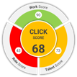





What We Do
“Talent to Value helps answer….
01
Do you have the right leadership team?
C-Suite Succession Management
Executive Assessment
02
Do you know the 20-30 critical roles across the organization that deliver 80% of value?
03
Do you have a minimally invasive plan to win?
C-Suite Team Effectiveness
Operating Model
Optimization
Critical Roles Identification
04
Is the Organization Designed for Success?
05
Is There Enough Capability to Deliver the Ambition?
Training & AI
People Diligence

Slide 15














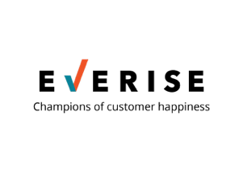







































































Our Clients
PRIVATE EQUITY
PROFESSIONAL SERVICES
RETAIL/ONLINE RETAIL FORUM
HEALTHCARE/HEALTH TECHNOLOGY
FINANCIAL SERVICES
MEDICAL DEVICES
ENERGY & INDUSTRIAL
IT SERVICES
PHARMECEUTICALS AND LIFE SCIENCES
EDUCATION
OTHER
CONSUMER PACKAGED GOODS
INSURANCE

